Slide 1

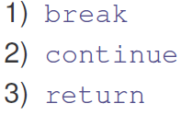
We understand each if these in detail

Slide 2

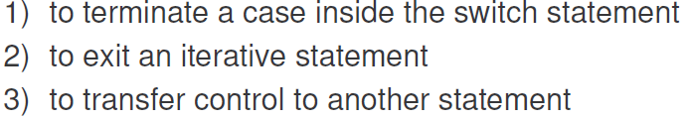


Slide 3
class BreakLoop
{
public static void main(String args[])
{
for (int i=0; i<100; i++)
{
if (i == 10)
break;
System.out.println("i: " + i);
}
System.out.println("Loop complete.");
}
}

Slide 4
Write a Program to achieve the output given below:
Pass i=0: and j=0 1 2 3 4 5 6 7 8 9
Pass i=1: and j=0 1 2 3 4 5 6 7 8 9
Pass i=2: and j=0 1 2 3 4 5 6 7 8 9
Loops complete.
Program has two loops (nested).
i loop counts from 0 to 2 and
j loop counts from 0 to 19
Note: the j loop counts only up to 9 though it can count till 19

Slide 5
Pass i=0: and j=0 1 2 3 4 5 6 7 8 9
Pass i=1: and j=0 1 2 3 4 5 6 7 8 9
Pass i=2: and j=0 1 2 3 4 5 6 7 8 9
Loops complete.
class NestedLoopBreak
{
public static void main(String args[])
{
for (int i=0; i<3; i++)
{
System.out.print("Pass i=" + i + ": and j= ");
for (int j=0; j<20; j++)
{
if (j == 10)
break;//Break loop j
System.out.print(j + " ");
}
System.out.println();
}
System.out.println("Loops complete.");
}
}// Click for output:

Slide 6
labeled break
However it supports labeled break
Lets understand it with a program.
Consider again the previous program:
Program has two loops (nested).
i loop counts from 0 to 2 and
j loop counts from 0 to 19
Write a code to achieve the following output:
Pass i=0: and j= 0 1 2 3 4 5 6 7 8 9 10 11 12 13 14 15 16 17 18 19
Pass i=1: and j= 0 1 2 3 4 5 6 7 8 9 10 11 12 13 14 15 16 17 18
Loops complete.
Note: the i loop counts only up to 1 though it can count till 2 and j counts up to 18 in last iteration

Slide 7
class BreakLabeled
{
public static void main(String args[])
{
first: for ( int i=0; i<3; i++)
{
System.out.print("Pass i=" + i + ": and j= ");
second: for ( int j=0; j<20; j++)
{
if (i==1 && j==19 )
break first; //Break loop i and j
else
System.out.print ( j + " ");
} //for j
System.out.println();
} // for i
System.out.println("\nLoops complete.");
} // main method
}

Slide 8
One more Program of labeled break. What is the O/p
class Break
{
public static void main(String args[])
{
int v=10;
first: {
second: {
third: {
System.out.println("Before the break.");
if (v==10)
break second;
System.out.println("This won't execute");
}
System.out.println("This won't execute");
}
System.out.println(“After second block.");
}
}
} // Click to see the output
Before the break.
After second block.

Slide 9
class BreakError
{
public static void main(String args[])
{
one: for(int i=0; i<3; i++)
{
System.out.print("Pass " + i + ": ");
}
for (int j=0; j<100; j++)
{
if (j == 10)
break one;
System.out.print(j + " ");
}
}
}
Compile time error; Undefined label “one”

Slide 10


Slide 11

Write a program to display the following output using for loop (0- 9) and continue statement.
Output:
0 1
2 3
4 5
6 7
8 9

Slide 12
class Continue
{
public static void main(String args[])
{
for (int i=0; i<10; i++)
{
System.out.print(i + " ");
if (i%2 == 0)
continue;
else
System.out.println("");
}
}
}
Output:
0 1
2 3
4 5
6 7
8 9

Slide 13

Write a program to print the following output
0
0 1
0 2 4
0 3 6 9
0 4 8 12 16
0 5 10 15 20 25
0 6 12 18 24 30 36
0 7 14 21 28 35 42 49
0 8 16 24 32 40 48 56 64
0 9 18 27 36 45 54 63 72 81

Slide 14
class LabeledContinue
{
public static void main(String args[])
{
outer: for (int i=0; i<10; i++)
{
for (int j=0; j<10; j++)
{
if (j > i)
{
System.out.println();
continue outer;
}
System.out.print(" " + (i * j));
}
}
System.out.println();
}
}

Slide 15

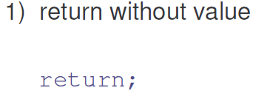
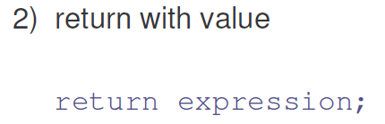
Lets see examples

Slide 16
class Return
{
public static void main(String args[])
{
boolean t = true;
System.out.println("Before the return.");
if (t)
return; // return to caller
System.out.println("This won't execute.");
}
}

